Slide 1
Elasticity

Slide 2
Elasticity
Elasticity is the term used in economics to explain the responsiveness of one variable to changes in another variable.
Price Elasticity of Demand is the term used to explain the responsiveness of the quantity demanded to a change in price
Note: Price Ed is always negative.

Slide 3
Price elasticity is a measure of the responsiveness of the quantity demanded to a change in price. It is calculated as the percentage change in quantity demanded to a percentage change in price .
When quantity demanded is very responsive to a change in price we say demand is elastic; when quantity demanded is not very responsive to a change, we say that demand is inelastic.

Slide 4
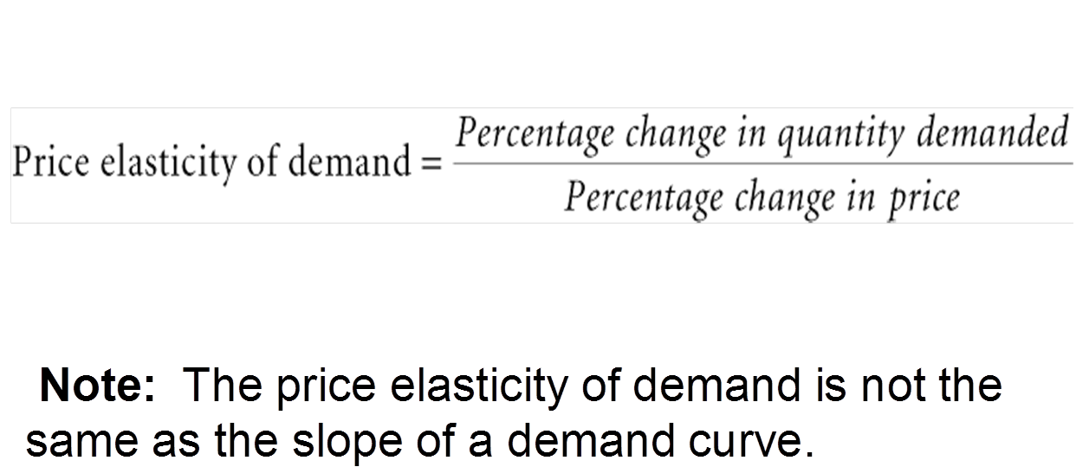
Elasticity of Demand
Price elasticity of demand
A measure of the responsiveness of the quantity demanded of a good to a change in its price (ceteris paribus).
= (∆𝑄 /𝑄)/(∆𝑃/𝑃)

Slide 5
Elasticity Types
Less Elastic: % change in Qty. demanded < % change in price
More Elastic: % change in Qty. demanded >% change in price
Unit Elastic :% change in Qty. demanded = % change in price
Perfectly Inelastic : change in price leads to no change in Qty. demanded
Perfectly Elastic: : any increase in price causes Qty. demanded to fall to zero.

Slide 6
Perfectly inelastic demand means that a consumer will buy a good or service regardless of the movement of price. In order for perfectly inelastic demand to exist, there can be no substitutes available.
An example would be food for a starving man
Another example would be insulin to a diabetic.
Perfectly elastic demand means that a consumer will not buy a good or service if the price moves at all.
An example would be pink tennis balls. If the price of pink tennis balls went up, no one would buy them in lieu of yellow tennis balls.

Slide 7
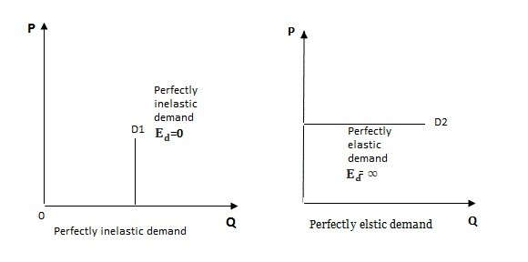
The following figure illustrates the most extreme cases: perfectly elastic demand ( at a higher price, quantity demanded decreases to zero) and perfectly inelastic demand ( a change in price has no effect on quantity demanded)

Slide 8

Price Ed measurement : mid point formula
$$\text{PED} \left(\text{MP}\right)\text{=}\frac{(\frac{∆Q}{average quantity})}{\left(\frac{∆P}{average price}\right)}$$
$$PED \left(MP\right)= \frac{\frac{\left(Q_{2− }Q_{1}\right)}{\left(\frac{Q_{1+}Q_{2}}{2} \right)}}{\frac{\left(P_{2− }P_{1}\right)}{\left(\frac{P_{1+}P_{2}}{2}\right)}}$$
This formula is used to estimate price elasticity of demand between 2 points on the same demand curve.

Slide 9
Determinants of the Price Elasticity of Demand

Slide 10
1.
Product | Price Elasticity of Demand | Is it inelastic?
Soft drinks | 3.18
Canned Soup | 1.62
Cheese | 0.72
Toothpaste | 0.45
a. The demand for which products is inelastic? Discuss reasons why the demand for each product is either elastic or inelastic
b. Use the information in the table to predict the change in the quantity demanded for each product following a 10 per cent price increase.

Slide 11
a.
Inelastic = Ed < 1, so cheese and toothpaste are inelastic - few substitutes and are necessities
Soft drinks and Canned Soup have wide substitutes, different types available and less necessary so not inelastic
b.
PED = 3.18 means a 1% change in Price results in a 3.18% change in Qd

Slide 12
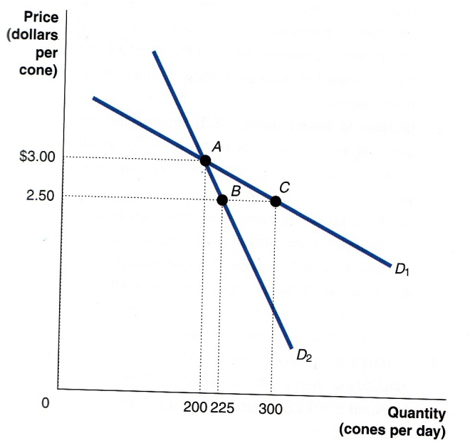
2.a Use the midpoint formula to calculate the price elasticity of demand for D1 between point A and point C and the price elasticity of demand for D2 between point A and point B. Which curve is more elastic, D1 or D2?

Slide 13
PED of D1 between points A and C
ΔQ or Q2 – Q1 = (300 – 200) = 100
Qave or (Q1 + Q2)/2 = (300+200)/2 = 250
ΔP or P2 – P1 = (3.00 – 2.50) = 0.50
Pave or (P1 + P2)/2 = (2.50+3.00)/2 = 2.75
PED (MP) = 2.20
PED of D2 between points A and B
ΔQ or Q2 – Q1 = (225‐200) = 25
Qave or (Q1 + Q2)/2 = (200+225)/2 = 212.5
ΔP or P2 – P1 = (3.00 – 2.50) = 0.50
Pave or (P1 + P2)/2 = (2.50+3.00)/2 = 2.75
PED(MP) = 0.647

Slide 14
2. b. Suppose Amirul is initially selling 200 cones per day at a price of $3.00 per cone. If he reduces his price to $2.50 per cone and his demand curve is D1, what will be the change in his revenue? What will be the change in his revenue if his demand curve is D2?

Slide 15
Amirul’s initial total revenue:
P X Q = $3X200 = $600
If she reduces her price from $3 to $2.50 and he is on D1 his total revenue
P X Q = $2.5X300 = $750
By reducing his price if he is facing D1 his revenue will increase by ($750-$600) $150. Elastic demand
If he reduces his price from $3 to $2.50 and he is on D2 his total revenue
P X Q = 2.50X225 = $562.50
By reducing his price if he is facing D2 her revenue will decrease by ($562.5-$600) $37.50 . Inelastic demand

Slide 16
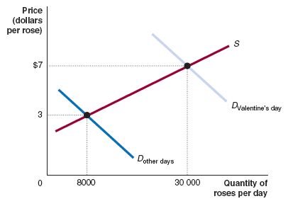
3. On most days prices of red roses are $1 and 8000 are purchased. On Valentine’s Day prices increase to $2 and 30 000 are purchased. a. Draw D&S diagram that shows why the price jumps.
$2
$1

Slide 17
b. Based on this information, what do we know about the price elasticity of demand of roses? Calculate values for the PED and the PES or explain why you cannot calculate these values.

Slide 18
we can’t calculate the price elasticity of demand
The demand curve has shifted, so the rise in the quantity of roses demanded is not caused by the rise in their price
we could calculate the price elasticity of supply for roses.
We have a movement along the supply curve

Slide 19
4. Rank the following 4 goods from lowest income elasticity to highest. Briefly explain your ranking.
a. Pepsi
b. Mercedes Benz cars
c. Personal computers
d. Bread
For normal goods
Necessity goods have income elasticity that is POSTIVE BUT LESS THAN ONE (decimal).
Luxury goods have income elasticity that is POSITIVE AND GREATER THAN ONE.
Inferior goods have negative income elasticity

Slide 20
5. Laboni always buys 50 litres of petrol every week, regardless of the price. Sakib always buys exactly $50 of petrol every week, regardless of the price. What is their elasticity of demand for petrol?

Slide 21
Laboni’s demand = perfectly inelastic. No matter what price, 50 litres is bought (vertical D curve). Price has no effect.
Sakib’s demand = unitary elastic. Always spends the same amount, so if prices change it will impact qty. Price has an effect.
If P = $1 he will buy 50 litres, $2 he will buy 25 litres, $0.50 he will buy 100 litres.
Note: unitary elasticity implies a situation where a change in the market price of a good results in no change in the total amount spent for the good within the market.

Slide 22
6. Indicate for each pair of goods below which good has the more elastic price demand and why:
a. fast food; pizza.
pizza market is narrowly defined relative to fast food
many close substitutes for pizza than fast-food
b. Shell petrol; petrol.
Shell is a band, brands are always more elastic than a broadly defined good as they are narrowly defined
Close substitutes of Shell are BP, Caltex
c. champagne; beer.
Champagne is a very expensive luxury product
d. male haircuts; female haircuts.
Male hair cuts are more elastic

